Slide 1

SMART BUS TICKET USING QR CODE
Tanya Dixit
Manthan Gadekar
Rutuja Ganakwar

Slide 2
Contents
INTRODUCTION
GOALS OF PROJECT
PROJECT BENEFIT
ARCHITECTURAL DIAGRAM
SYSTEM DESIGN
IMPLEMENTATION
CONCLUSION

Slide 3
Introduction
Smart tickets have proven to be a cost-efficient replacement for paper tickets, which by comparison are more expensive to distribute, validate, and keep track of.
Paper tickets are also easier to lose, are subject to wear and possible counterfeiting, and are far less ecologically friendly.
Smart tickets allow passengers to skip queues, speed up the boarding of trains, and not lose money if the cards or phones are lost or stolen.
They also allow passengers to easily add to their existing balances or occasionally change itineraries if necessary.

Slide 4
Goals of a Project
Issues an e-Ticket to all the users.
An application that utilizes QR-Code that supports express bus integrated e-Ticket.
Allow users to pay for ticket online.
To improve the management process easily and systematically.
Saves time, affordable and comfortable.

Slide 5
Project Benefits
Reduced Boarding Time.
Reduction in Cash-handling procedures.
Faster Time-to-Market.
Better Customer Service.

Slide 6
Software Requirements Specification [SRS]
Operating system
Windows XP and others.
Front End
Java, Android Studio
Backend Database
Firebase database
Browser
Chrome, Internet Explore and any other

Slide 7
System Diagram
Architecture Diagram
HOME PAGE
LOGIN PAGE
CREATE ACCOUNT
ADD DETAILS OF USER
BOOKING PAGE
SUBMIT PAGE
VERIFICATION PAGE

Slide 8
User Case Diagram
Admin User
LOGIN PAGE
MANAGE PAGE
CREATE ACCOUNT PAGE FOR USER
USER DETAILS PAGE
SUBMIT PAGE
VERIFICATION PAGE OF ADMIN/USER

Slide 9
Sequence Diagram
Login
Create account
Requirement
Verification
Get QR code

Slide 10
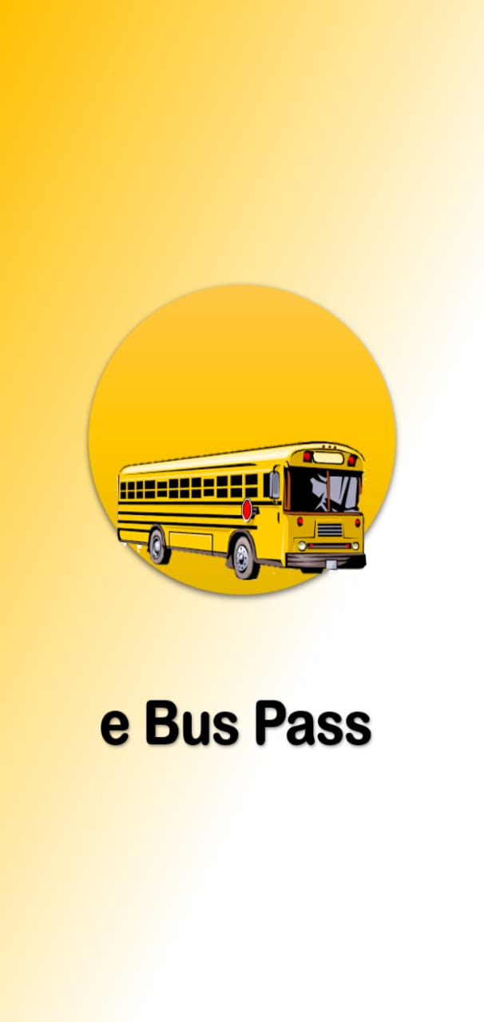
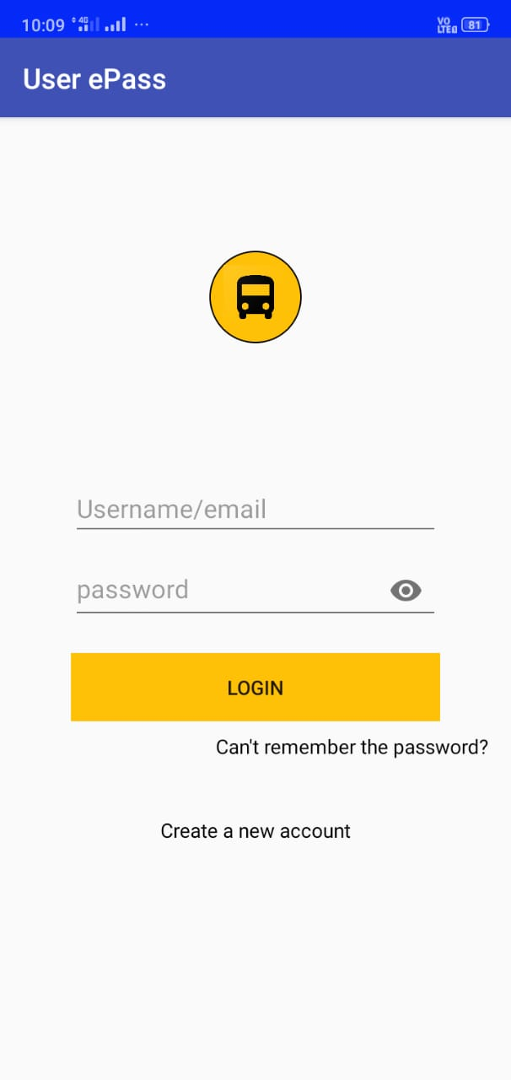
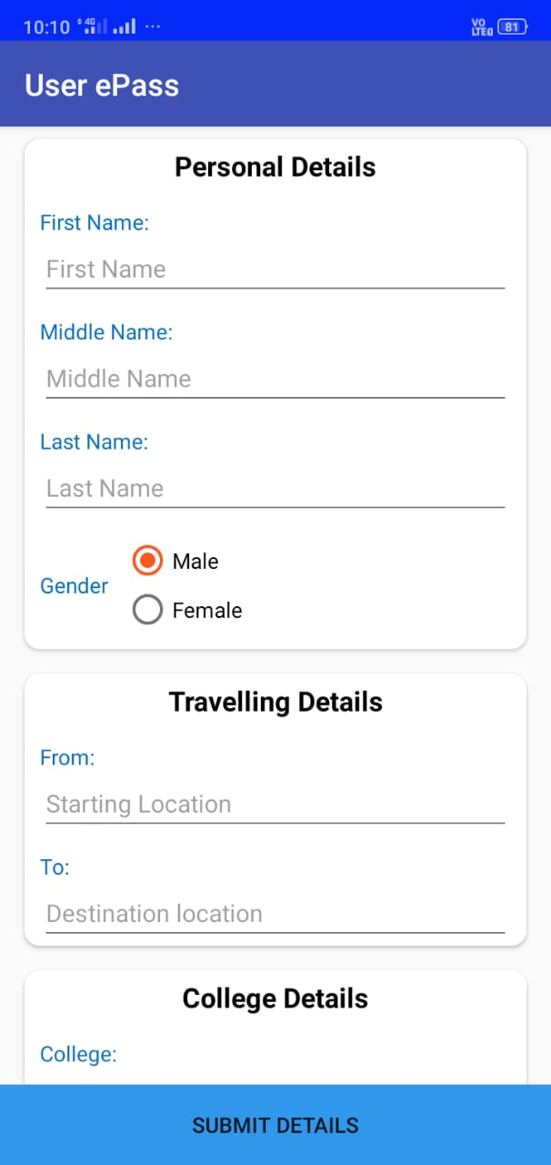
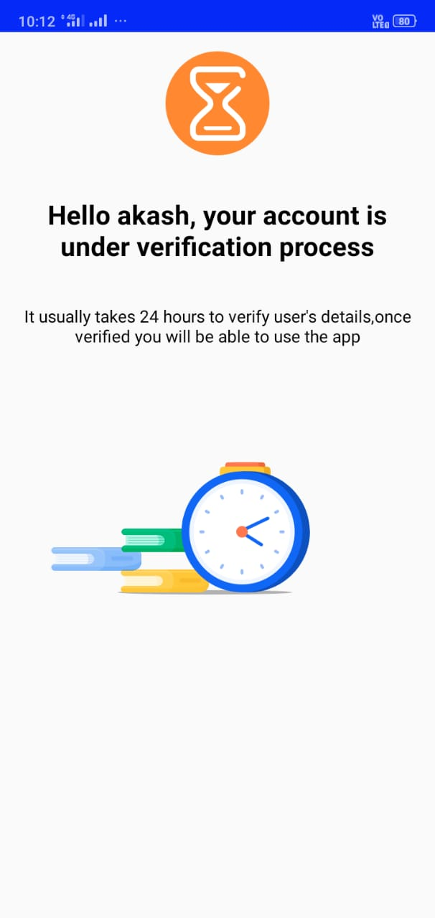
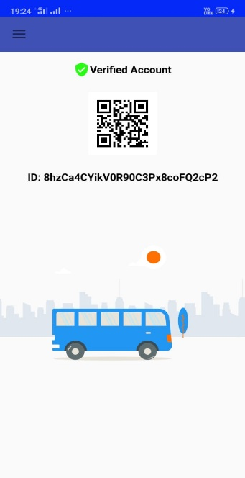
Implementation for user

Slide 11
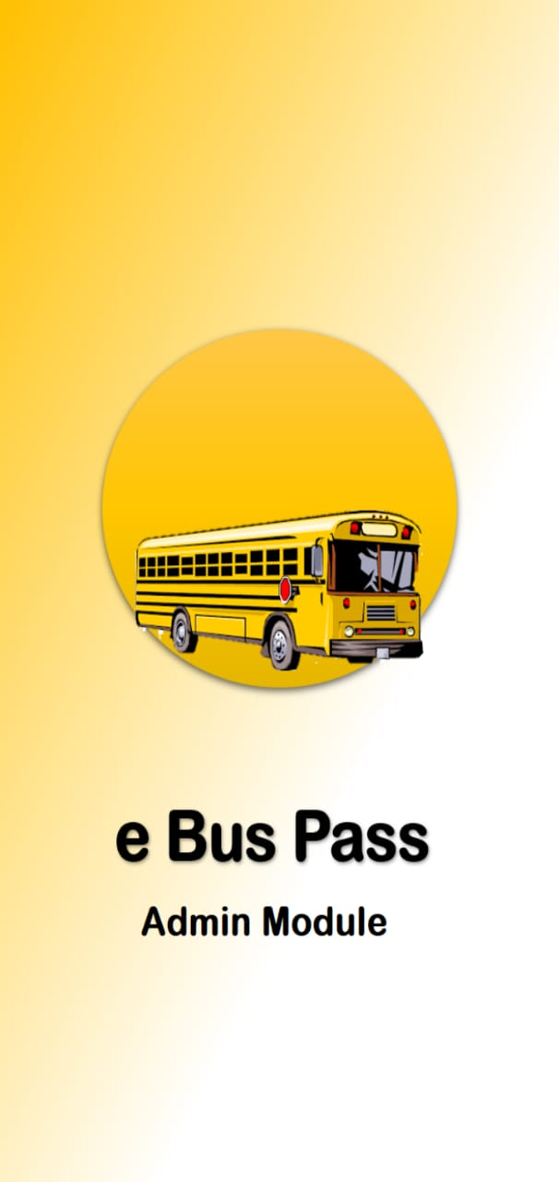
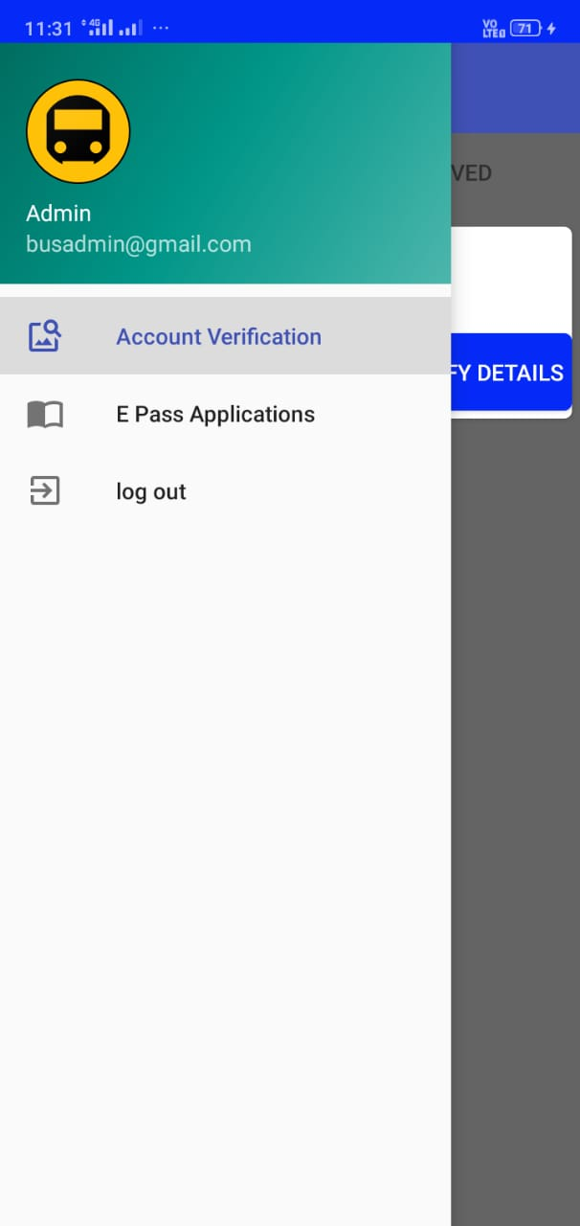
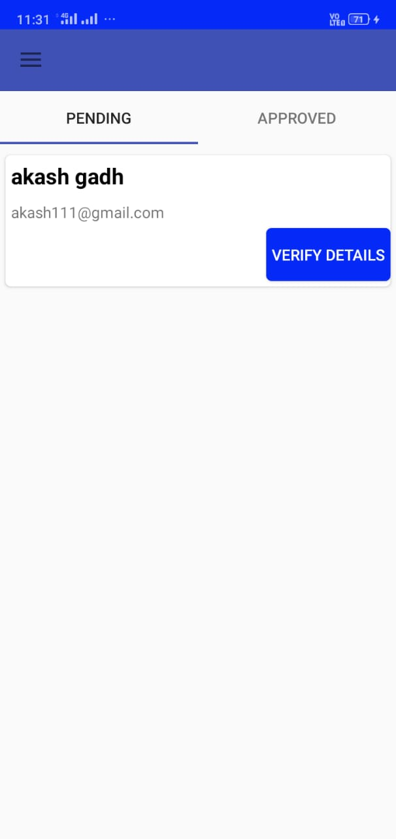
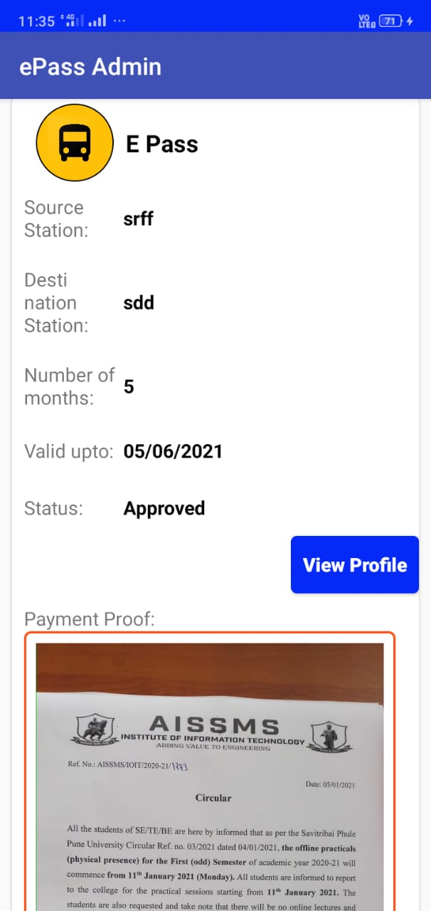
Implementation for Admin

Slide 12
Conclusion
Mobile ticketing is simply making your phone a ticket machine, right into your pocket. This eliminates the need for users to carry bills or wait in a long queue to purchase a ticket.
Effective and efficient process benefits daily passengers and the ones who are planning or scheduling trips frequently.
With its growing demand in the people looking for the online ticket reserving services.
Pay as you go services. No extra upfront costs to be paid.

Slide 13
THANK YOU!

